Slide 1
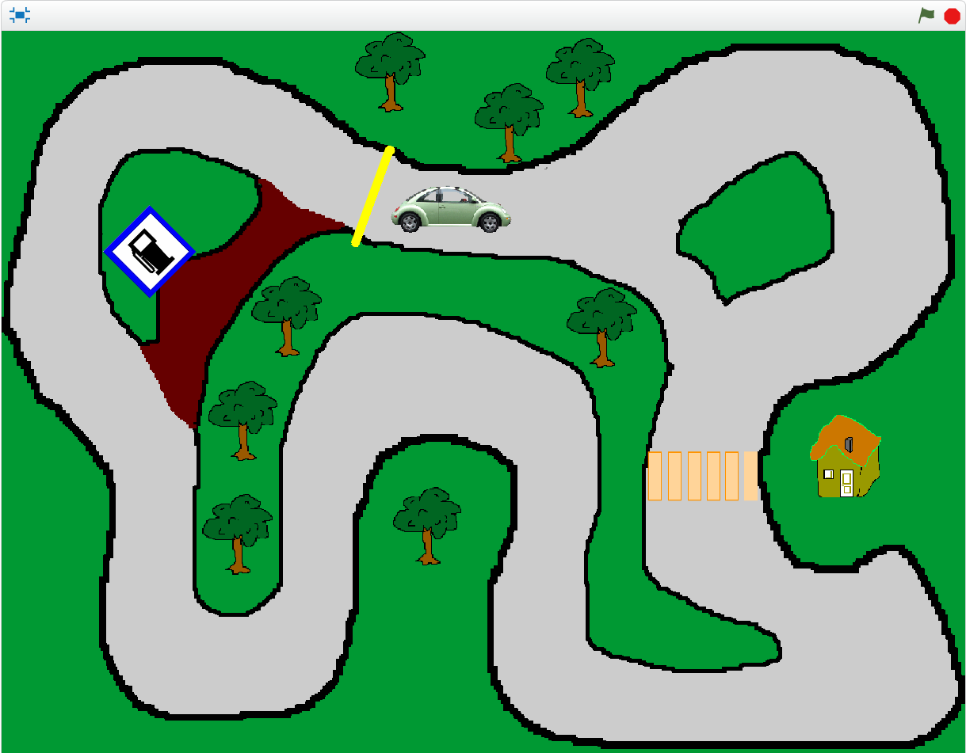
Circuit Scratch
3
https://onvaessayer.org

