Slide 1
Welcome
to
Mobile CSP!
Acknowledgment and Disclaimer: This presentation is supported in part by the National Science Foundation under Grants 1240841, 1225680, 1225719, 1225745, 1225976, and 1226216. Any opinions, findings, and conclusions or recommendations expressed in these materials are those of the authors and do not necessarily reflect the views of the National Science Foundation.

Slide 2
Mobile CSP
Programming in App Inventor
Learning basic Principles of Computer Science
and

Slide 3
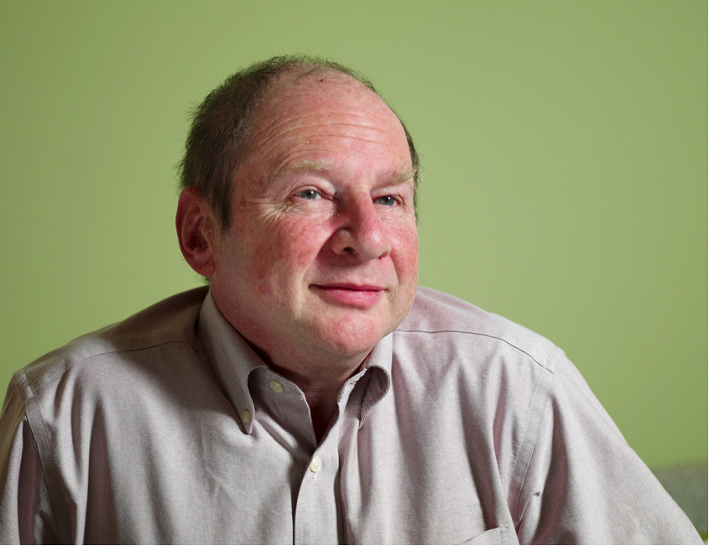
Democratizing Computer Programming
Hal Abelson, MIT
Creator of App Inventor
Everyone should be able to tinker with their mobile device.

Slide 4
Demo
Looking up UPC Codes

Slide 5
Some more sample apps

Slide 6
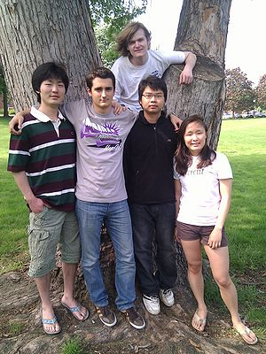
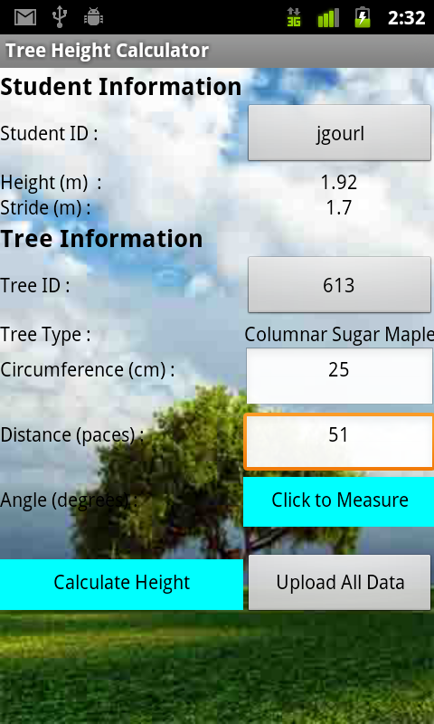
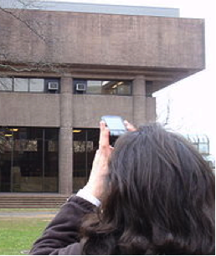
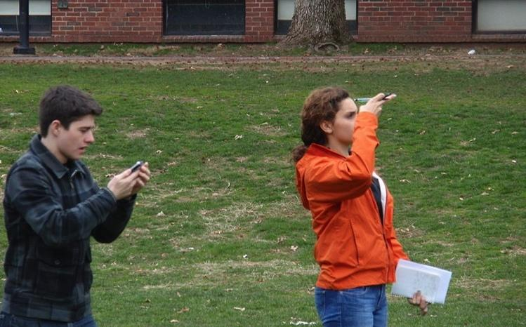
Trinity College students made an app to Estimate Tree Height
http://notes.hfoss.org/index.php/TreeCalc:Main_Page

Slide 7
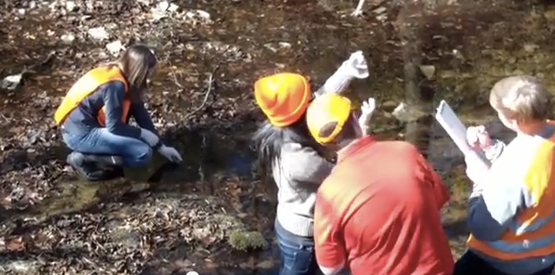
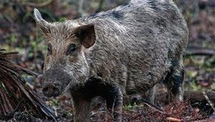
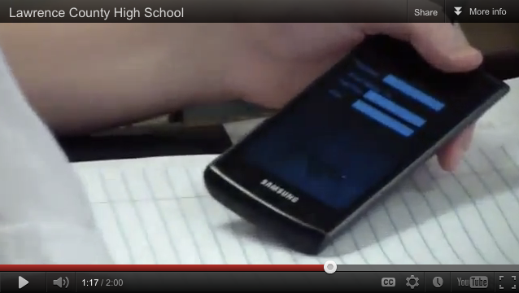
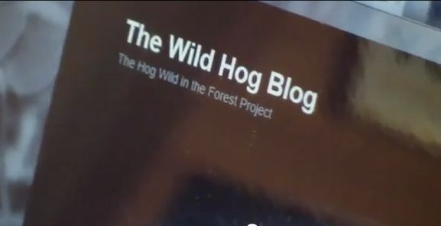
Alabama high school students made an app to Track Wild Hogs

Slide 8
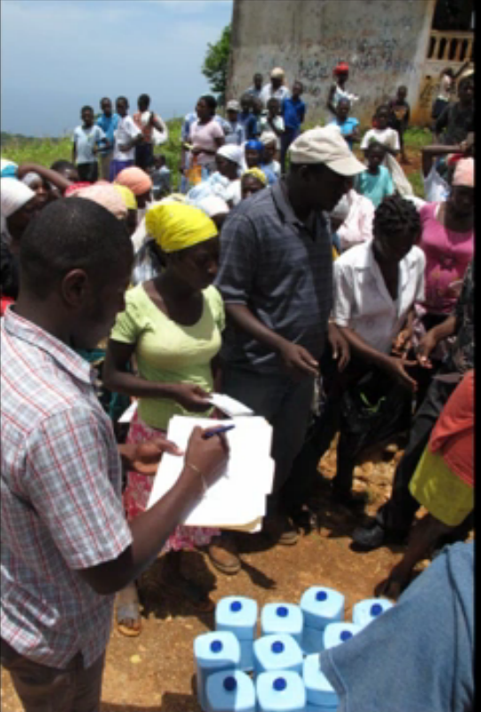
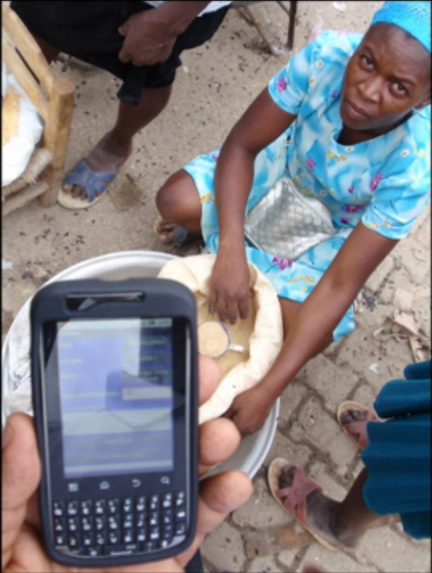
Trinity College students made an app to Track commodity prices in Haiti markets
BEFORE
AFTER
Notes:
Blocks editor

Slide 9
MIT students made an app to help
Diabetics test their blood sugar

Slide 10
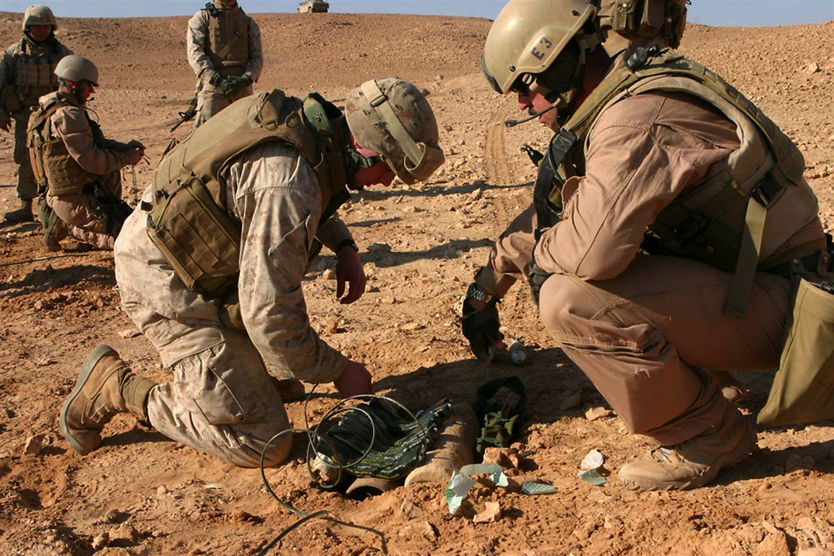
A U.S. Marine made an app to
Compute the amount of explosives needed to destroy IEDs

Slide 11
The Computer Science Principles Curriculum

Slide 12
CS Principles
http://csprinciples.org
Computer Science Principles
is a proposed AP course that seeks to broaden participation in computer science. Development is organized by the College Board and supported by the National Science Foundation.

Slide 13
Here are the seven big ideas we will learn
about in this course
Creativity -- You’re going to create lots of cool apps.
Abstraction -- You’ll learn what abstraction is and how it figures into computer science.
Data -- You’ll see how to use data to create new knowledge.
Algorithms -- You’ll learn algorithms for solving interesting problems.
Programming -- You’ll learn the fundamentals of programming.
Internet -- You’ll learn how the Internet works.
Impact -- You’ll reflect about the positive and negative impacts of computing on today’s society.

Slide 14
Let’s get started!

